Slide 1
Introduction to Blockchain
June 29, 2018
Blockchain CoE, Pune

Slide 2
Agenda
Blockchain Example
Issues with Current World Systems
What Is Blockchain Technology?
Need for Distributed Ledgers… The Finance IT problem statement
Major Blockchain Components
Types of Distributed Ledgers
Gartner Emerging Technology Hype Cycle
Benefits of Blockchain Implementation
Blockchain Usecases
Issues/Concerns of Blockchain
Blockchain Technologies
Q & A

Slide 3

Blockchain Example
Current World Scenario: Transaction within same bank:
Bank A
5
Alice
Bob
Bank A - Ledger before transaction :
Bank A - Ledger after transaction :
Id | Holder | Currency | Amount
1 | Alice | USD | 10
2 | Bob | USD | 5
Id | Holder | Currency | Amount
1 | Alice | USD | 5
2 | Bob | USD | 10

Slide 4
Blockchain Example (contd..)
Current World Scenario: Transaction between different banks:
Bank A
Interface
Bank B
5
Alice
Correspondent Banking Arrangement
Charlie
Bank A - Ledger before transaction :
Bank B - Ledger before transaction :
Id | Holder | Currency | Amount
1 | Alice | USD | 10
2 | Bank B | USD | 1000
Id | Holder | Currency | Amount
1 | Charlie | USD | 5
2 | Bank A | USD | -1000
Bank A - Ledger after transaction :
Bank B - Ledger after transaction :
Id | Holder | Currency | Amount
1 | Alice | USD | 5
2 | Bank B | USD | 995
Id | Holder | Currency | Amount
1 | Charlie | USD | 10
2 | Bank A | USD | -995

Slide 5
What are the issues with Current World Systems?
Key Issues with existing systems -
Need for an interface between the banks
Need to maintain correspondent banking arrangement
Reconciliation of data
Duplication of data
Different systems for Auditors
Duplication of logic for processing the transactions
Huge cost

Slide 6
Blockchain Example (contd..)
Blockchain World Scenario: Transaction between different banks:
Bank A
Bank B
5
Alice
Charlie
Distributed Ledger before transaction :
Id | Issuer | Holder | Currency | Amount
1 | Bank A | Alice | USD | 10
2 | Bank B | Charlie | USD | 5
Distributed Ledger after transaction :
Id | Issuer | Holder | Currency | Amount
1 | Bank A | Alice | USD | 5
2 | Bank B | Charlie | USD | 10

Slide 7
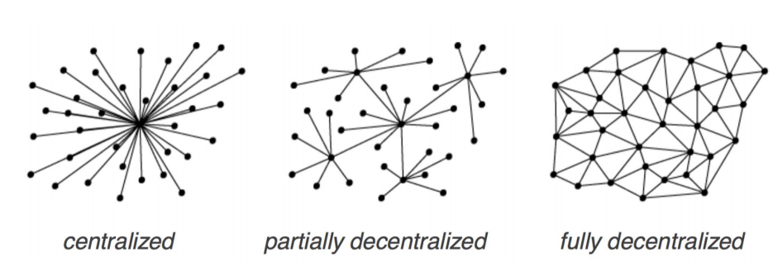
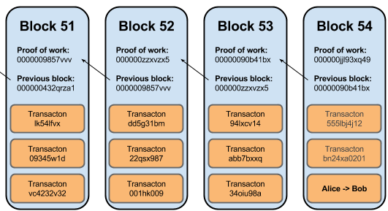
What Is Blockchain Technology?
Distributed ledgers are systems that enable parties
who dont fully trust each other
to form and maintain consensus
about the existence, status and evolution of a set of shared facts
spread across multiple sites/countries/institutions (nodes)
A Blockchain is
a type of distributed ledger
comprised of unchangeable, digitally recorded data(transactions)
bundled in packages called blocks
these blocks are linked to each other to form a chain

Slide 8
What Is Blockchain Technology?
How is Distributed Ledgers different from distributed databases?
Distributed databases don’t have different nodes being run by different parties
In Distributed databases, all nodes are under the control of a central party
What is difference between Bitcoin and Blockchain?
Bitcoin is virtual crypto currency
Blockchain is the backend system which stores Bitcoin on to the Distributed Ledger

Slide 9
Need for Distributed Ledgers… The Finance IT problem statement…
Problem Statement - In finance, parties don't fully trust each other but need to build consensus among them about shared facts – agreements, contracts, deals and so on.
Key Issues with existing Finance IT systems –
proliferation of systems that exists between financial institutions
the same information is recorded in multiple places by different parties in different systems all slightly different
there is a huge amount of work through reconciliation, matching to bring their systems back into consensus
the existing platforms or solutions are not designed to solve the problem statement
The Distributed Ledger Technology can bring in consensus and remove discrepancies, duplication and errors in the existing IT systems resulting in
same data “view” across all shared parties
reduction in cost and duplication out of IT systems
same data processing logic across all shared parties to process the data (smart contract)

Slide 10



Major Blockchain Components
Decentralized
Validity & Consensus
Cryptographically Secure Authentication
Digital Asset
Unique & Immutable Ledger
Smart Contract

Slide 11
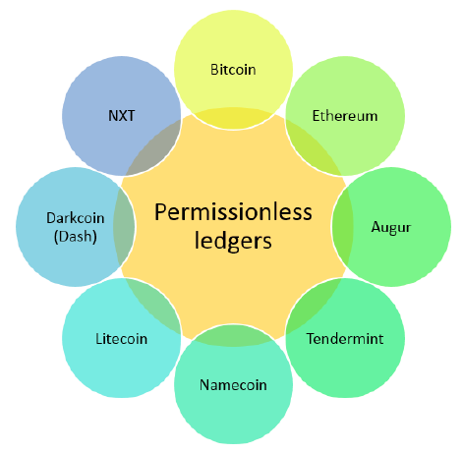
Types of Distributed Ledgers

Slide 12
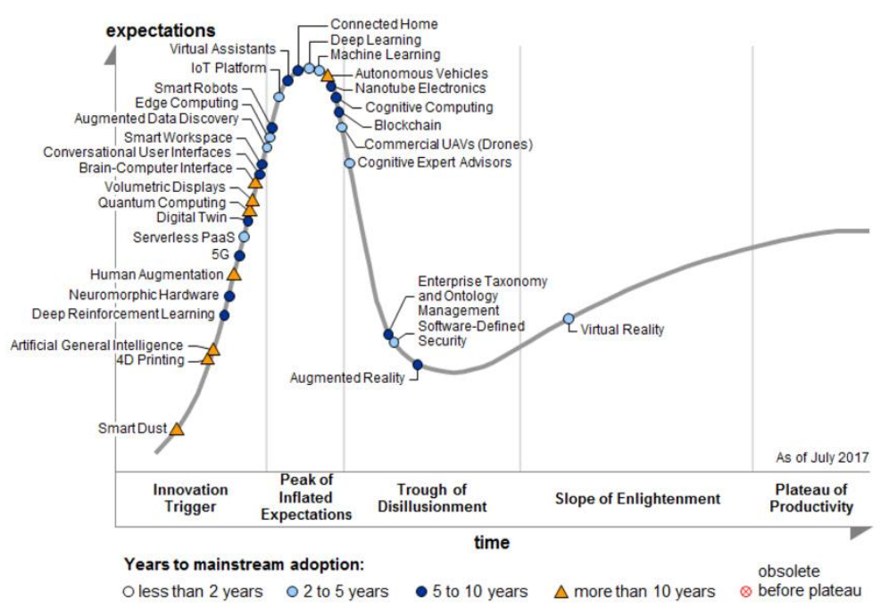
Gartner Emerging Technology Hype Cycle 2017

Slide 13


Benefits of Blockchain Implementation
$
Reduce Cost
75% %
Potential savings projected by a leading insurer with implementing a Catastrophe Bond on a blockchain.
Removes cost of intermediaries
Smart contracts reduce manual processing, re-work and processing errors
$20B
Blockchain technologies could reduce banks' infrastructural costs by $15-20bn a year by 2022.
Increase Revenue
$10B
UBS donated blockchain-based trading platform to be used to raise $10B selling social impact bonds.
New Products and Services
2M
Grammy nominated artist Imogen Heap launched her single ‘Tiny Human’ on a blockchain based platform Ujo Music to her 2M Twitter followers.
Reduce Risk
No single point of failure or attack
Non-repudiability reduces risk of fraud
Immutability and provenance preserves audit trail
360º
A leading insurer is looking to implement a KYC solution to build a 360º Customer view on a blockchain.
$10B
Global spend on Anti-Money Laundering compliance alone is estimated at $10B.
Increase Speed and Customer Satisfaction
Allows T+0 settlement
Simplifies supply chain removing intermediaries
Guarantees supply chain provenance
0
Several trading houses are looking to leverage blockchain technologies to allow T+0 trade settlements.

Slide 14
Use cases suited for Blockchain
Lightweight financial systems:
A Financial system which will allow a group of financial entities to transact and exchange assets between them
e.g.: loyalty points, banking applications
Provenance tracking:
Tracking the origin and movement of high value assets across a supply chain
e.g.: movement of high value items across supply chain, land registry
Interorganizational record keeping:
Blockchain can provide a mechanism for collectively recording and notarizing any type of data, whose meaning can be financial or otherwise
e.g.: KYC
Multiparty aggregation:
This usecase is technically same as above but the motivation is different - to overcome the infrastructural difficulty of combining information from a large number of separate sources
e.g.: reciprocal sharing arrangement for common customer set across banks

Slide 15
Issues/Concerns of Blockchain
Blockchains are not suited for high frequency transaction volumes. A Bitcoin transaction, by design, will get one confirmation after an average of 10 minutes.
Irreversible transactions (e.g. the DAO Hack)
Shift from centralized authority to and autonomous, digital and decentralized network for trusted P2P transactions challenges societal and economic norms
High Deployment cost as the size of decentralized ledger will be bigger than the centralized ledger

Slide 16
Blockchain Technologies
Hyperledger: Hyperledger is a permissioned, shared ledger developed as part of Linux Foundation. There are currently two incubator projects under the Hyperledger umbrella: “Fabric” and “Sawtooth Lake.
Corda: R3 Corda is a distributed ledger platform designed from the ground up to record, manage and synchronize financial agreements between regulated financial institutions.
Ethereum: Public blockchain platform that can run smart contracts. Has its own cryptocurrency – Ether
BigchainDB: BigchainDB is "a scalable blockchain database” capable of one million writes per second. It is built upon a big data distributed database (RethinkDB) and is capable of blockchain characteristics - decentralized control, immutability, creation and movement of digital assets
Eris (Monax): Platform to connect to various blockchains in a standardized way without the need to learn new commands when switching from one blockchain to another.

Slide 17
Thank You
Q & A

Slide 18
References
http://www.blockchaintechnologies.com/blockchain-definition
https://gendal.me/2016/11/08/on-distributed-databases-and-distributed-ledgers/
https://www.weforum.org/agenda/2015/11/how-will-blockchain-technology-transform-financial-services/
https://gendal.me/2016/10/25/
Consensus-as-a-service: a brief report on the emergence of permissioned, distributed ledger systems by Tim Swanson
http://www.multichain.com/blog/2016/05/four-genuine-blockchain-use-cases/
https://www.gartner.com/smarterwithgartner/top-trends-in-the-gartner-hype-cycle-for-emerging-technologies-2017/

